Slide 1

Product Wizard
Mobile Application

Slide 2
Product Wizard Overview
Product Wizard is a lightweight mobile application that allows its users to scan or input the barcode of products and return the information of that specific product.
This mobile application utilizes the device camera to scan the barcode of many different products. If the product isn’t registered, users have the ability to enter the product information and add it to the users personalized product list.
ProductWizard

Slide 3





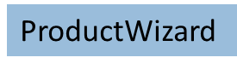
Deployment Environment
Google Play Store
Business
Education
Document editor/reader, package tracking
Exam preparations, Study-Aids, Vocabulary
Entertainment
Lifestyle
Streaming Video, Movies, TV, Interactive Entertainment
Style Guides, Wedding and Party Planning, How-to- Guides.
*NB This chart represents the top four app categories in the play store

Slide 4






Product Wizard
Requirements and Configuration
Internet Connection
Access to Google Services
Mobile Device has Camera
Android Version 4.4(Kit Kat) API Level 19 / Higher
IOS Version 10/ Higher

Slide 5
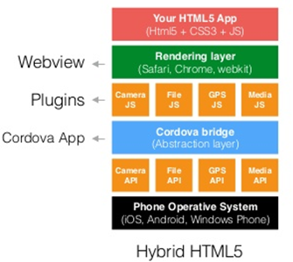
Product Wizard
Layered Architecture
ProductWizard

Slide 6

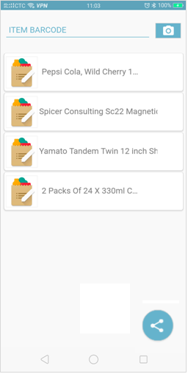
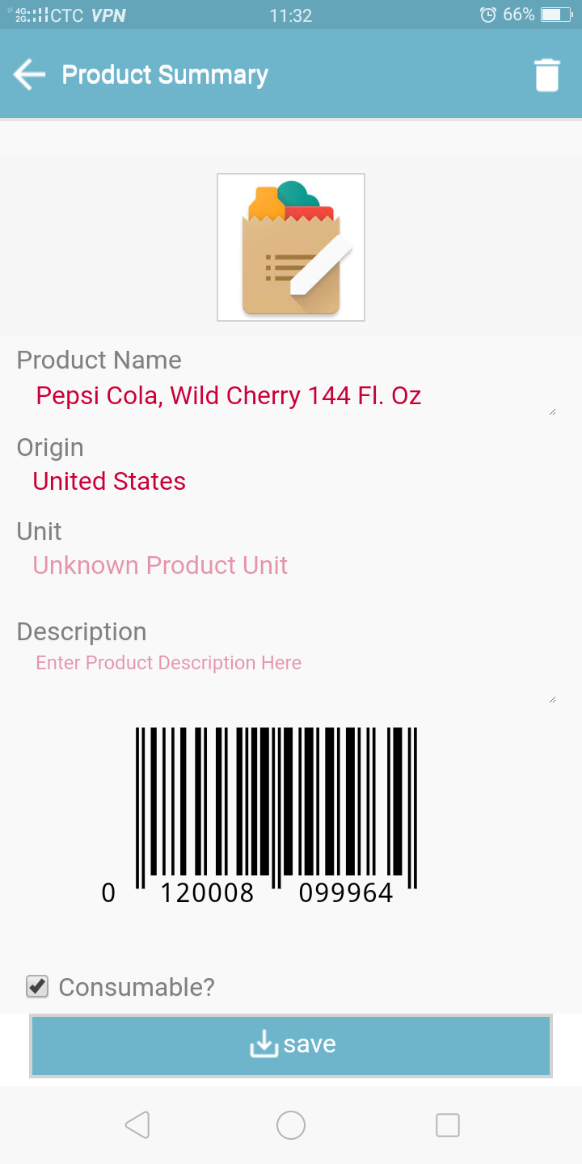
Product Wizard
Application Sleek UI Design
Product Wizard’s User Interface has been designed with its users in mind. The home screen offers the user a choice between entering the numerical item code or scanning the items barcode. For an easy and hassle free usage, a simple interface was used.
ProductWizard

Slide 7
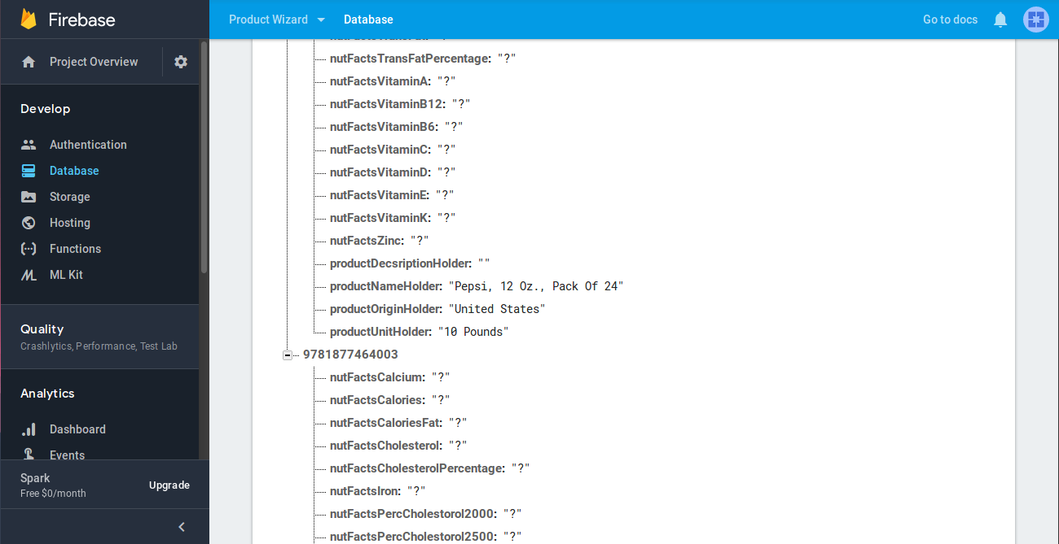
Product Wizard
Product Database

Slide 8
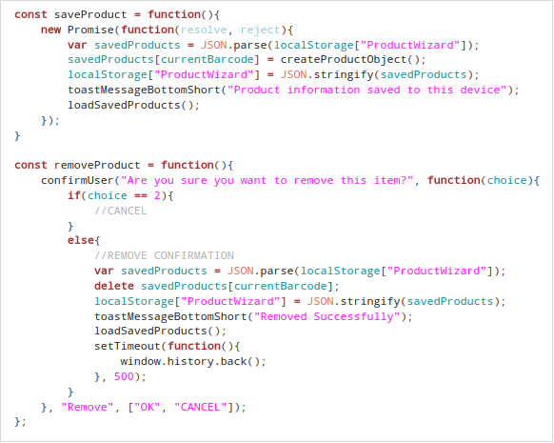
Product Wizard
Source Code for Saving and Removing Product from Database

Slide 9
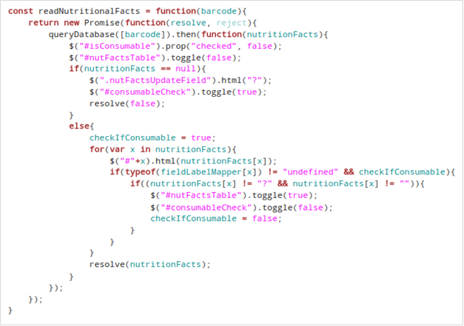
Product Wizard
Source Code for Reading Nutritional Facts of a Product

Slide 10
DEMo

Slide 11
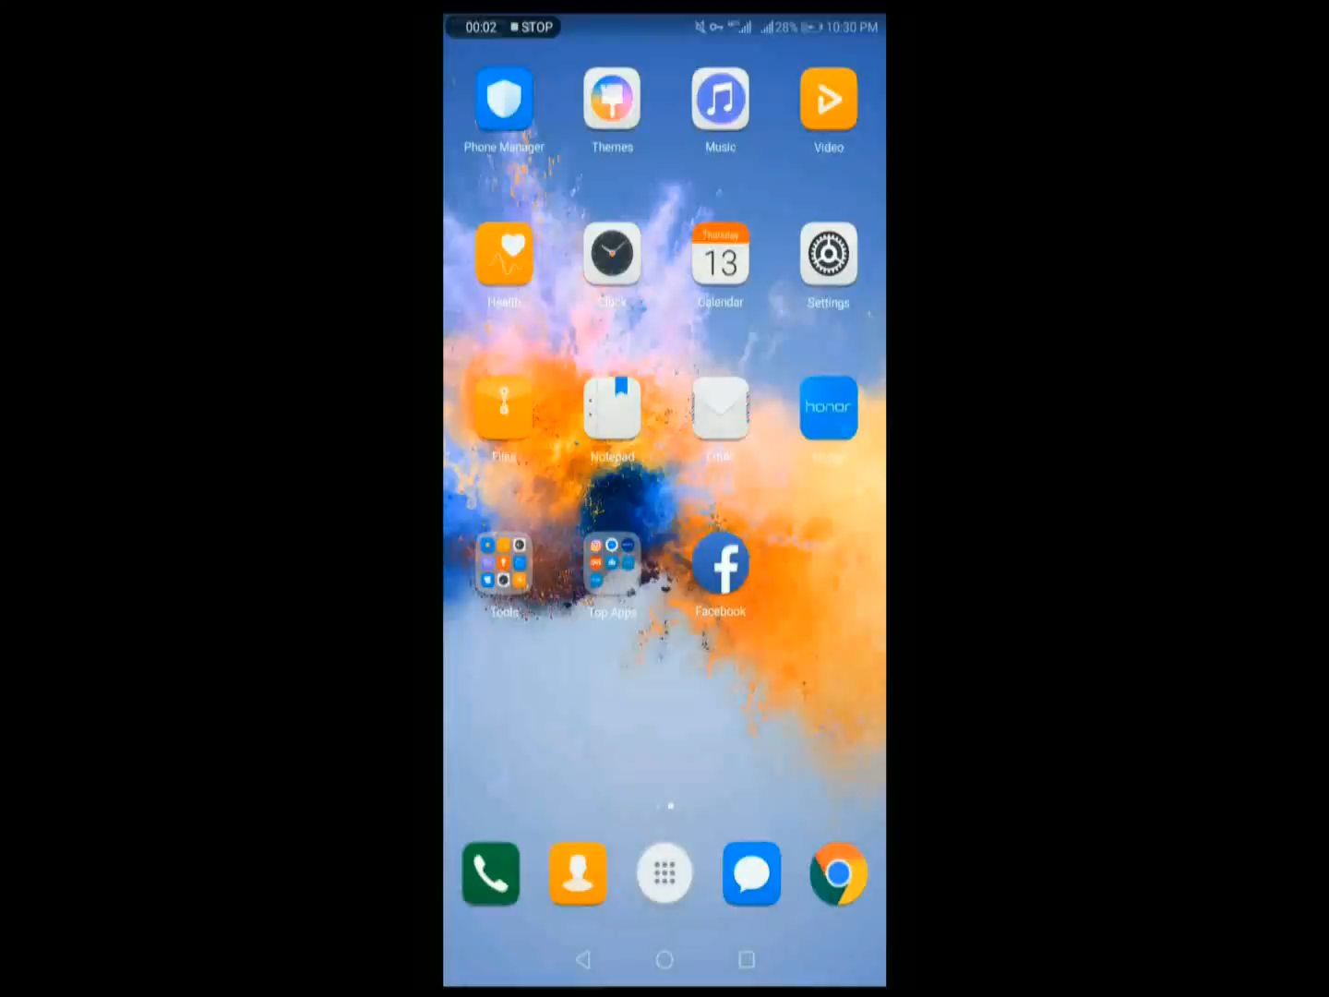
Product Wizard
Demo

Slide 12
Thank You
K.O.D Inc

